Slide 1
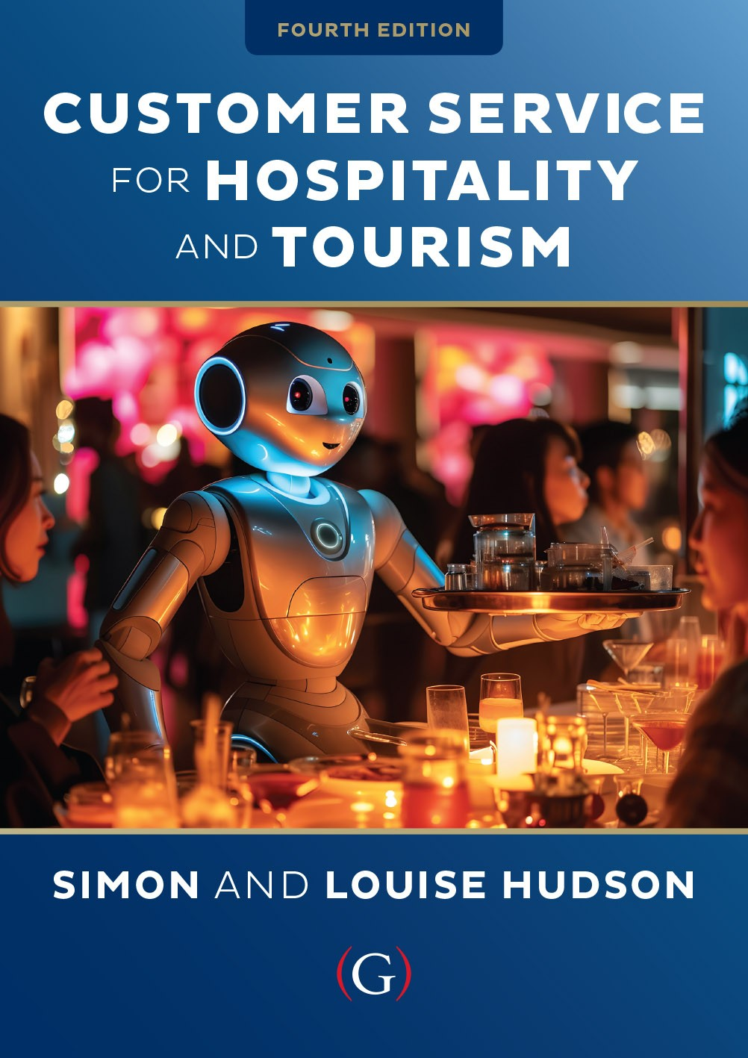
Chapter 1
Introduction to customer service

Slide 2
Topics Covered
Customer service defined
A history of customer service
The role of customer service
  Unique characteristics of services
  Services marketing triangle
  The services marketing mix
Customer service in tourism and hospitality

Slide 3
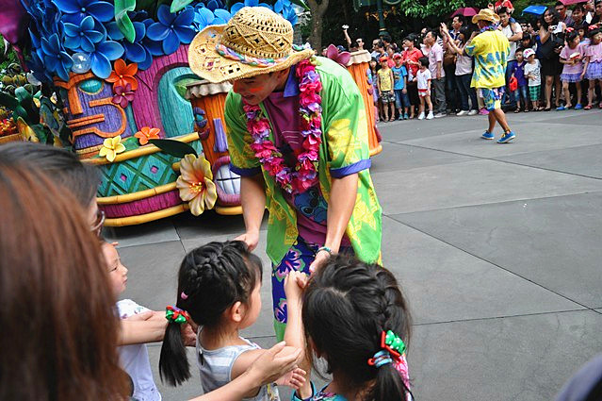
‘At Your Service Spotlight’: Walt Disney – a legacy of customer service
Disneyland is a work of love. We didn’t go into Disneyland just with the idea of making money’.
Walt’s personal philosophy (values, morals, religious beliefs, creative goals, innate psychographic awareness)
The company still holds true to his basic beliefs – and has diversified to incorporate cruises, TV channels, film studios and a training institute
Commitment to customers - a focus on the guest experience rather than traditional business efficiencies
Disney was hit hard by the pandemic
but guest satisfaction scores were
higher after re-opening than before.
In December 2021, Disney elected a
woman to chair its board – Susan Arnold
– for the first time in its 98-year history.

Slide 4
Customer service
Many attempts have been made to define customer service
The definition used in this book is as follows:
“Customer service is the practice of delivering products and services to both internal and external customers via the efforts of employees or through the provision of an appropriate servicescape.”
It acknowledges that customer service is more that interaction between employees and customers
It also relates to the physical infrastructure or the hospitality ‘servicescape’

Slide 5
History of customer service
1800s Craftsman economy
  Business owners also frontline employees
  Customized orders
20th century mass production
  Less individualized service
  Post WWII demand: Power of suppliers surpasses that of consumers
  1970s: Western manufacturers compete with Asia
  1990sL Suppliers more selective
Present day: Shift to service economy

Slide 6
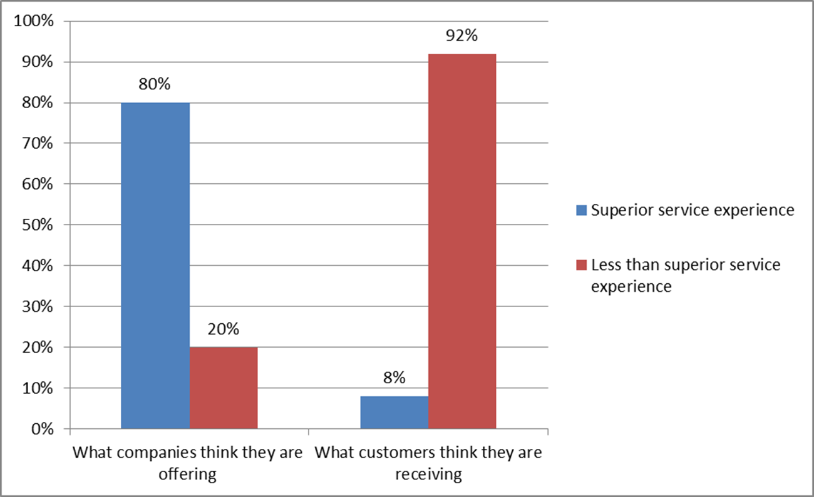
Reasons companies may not provide excellent customer service include….
Companies wrongly believe they are providing service excellence
Organizations don’t understand the significance of customer service
Companies don’t know how to deliver consistent, high quality customer service on an on-going basis

Slide 7
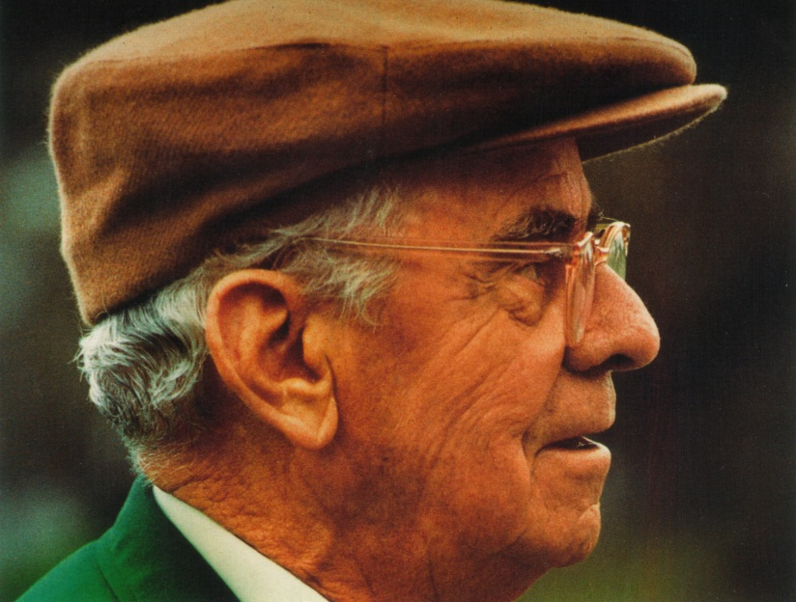
Snapshot: Customer service at the Augusta Masters
‘In the race for excellence, there is no finishing line’.
Many key features of professional golf tournaments introduced in Augusta
Focus on serving ‘Patrons’ and was the ‘first’ in many areas:
  Bleachers, rope galleries, closed circuit TV, on-course scoreboards
  Picnicking grounds, plenty of lavatories
  Great value food –
Still the competition by which others are judged
  3,500 staff employed every year
  They look for ‘a special kind of person’
  Clifford’s principles are guiding philosophy

Slide 8
Role of customer service
Models to assist in services marketing and management decisions at the strategic and implementation levels:
Four unique characteristics of services
The services marketing triangle
The marketing mix for services

Slide 9
Unique characteristics of services

Slide 10
The services marketing triangle

Slide 11
Expanded Marketing Mix for Services

Slide 12
Additional 3 ‘P’s of Services Marketing
People | Physical evidence | Process
1) Employees | 1) Facility design | 1) Flow of activities
- Recruiting | 2) Equipment | - Standardized
- Training | 3) Signage | - Customized
- Motivation | 4) Employee dress | 2) Number of steps
- Rewards | 5) Other tangibles | - Simple
- Teamwork | 6) Reports | - Complex
2) Customers | 7) Business cards | 3) Customer involvement
- Education | 8) Statements
- Training | 9) Guarantees

Slide 13
Customer service in tourism and hospitality
….activities of persons travelling to and staying in places outside their usual environment for not more than one consecutive year for leisure, business and other purposes not related to the exercise of an activity remunerated from within the place visited (UNWTO)
Demand for a wide range of travel and hospitality products
Total market now serviced by the world’s largest industry
    International tourism arrivals: 50 million in 1950 to 1.4 billion in 2024.
    Worldwide hospitality sector attained a valuation of $4,673 billion in the year 2023, constituting about 4.5% of the global Gross Domestic Product
    Tourism and hospitality are deeply intertwined.
    Satisfaction levels for some tourism and hospitality players are lagging behind other sectors

Slide 14
Customer service superstars

Slide 15
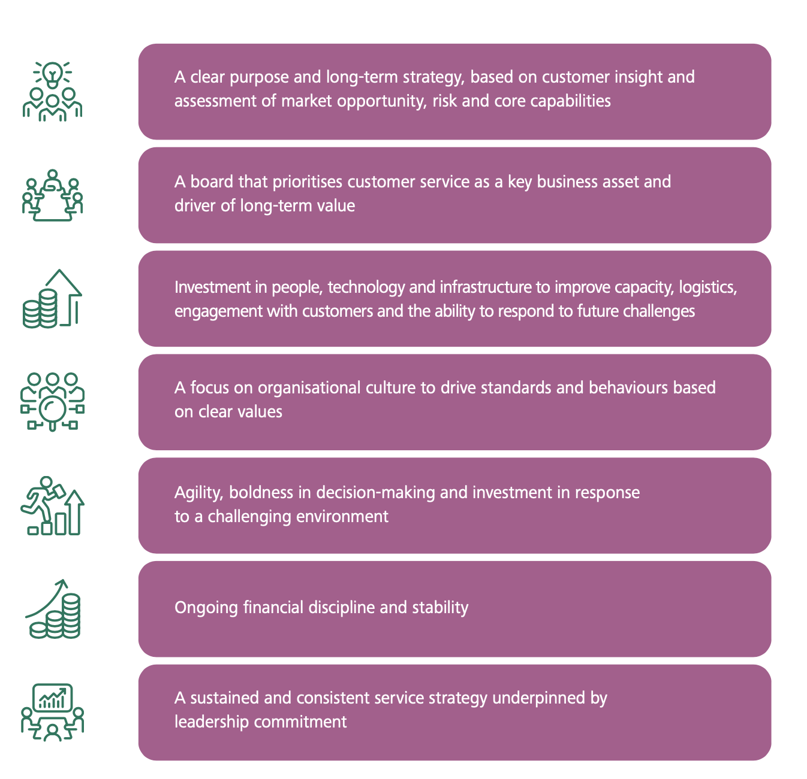
Common characteristics of organizations that consistently achieve high levels of customer satisfaction

Slide 16
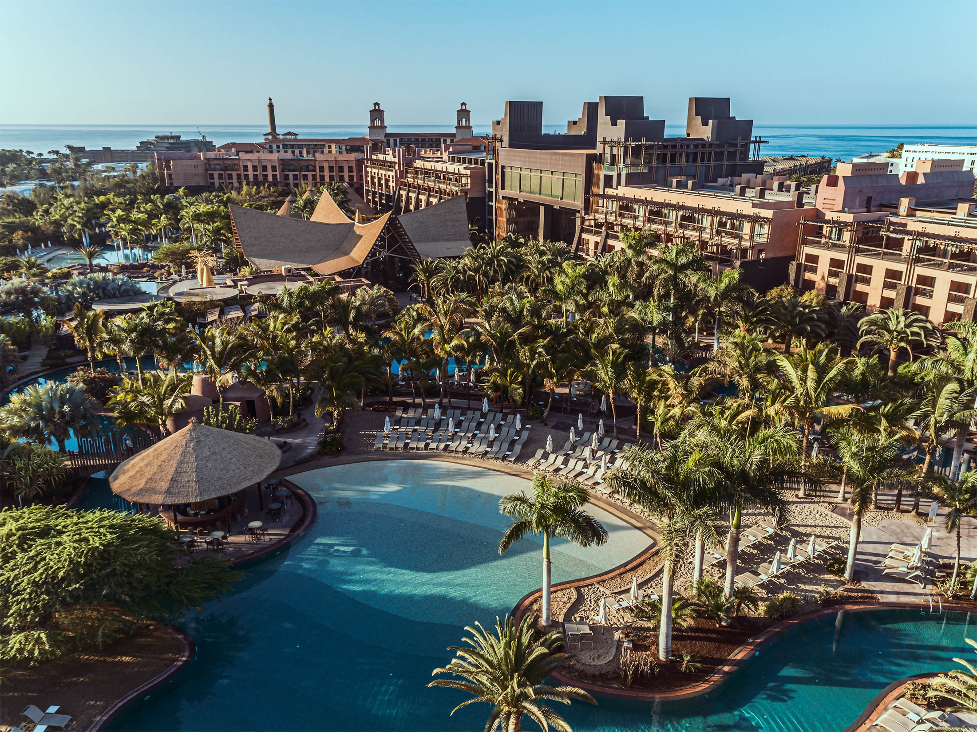
Case Study: The Lopesan Group, Gran Canaria, Spain
‘There’s no second chance for a first impression’
Five-star hotels, beach, restaurants, shopping malls, golf course
African-themed: Jungle foliage, calls, scents
40 % repeat customers
Attention to detail
  Cocktails at check-in
  Televisions on guest’s language channel
  Staff track personal preferences
  Complementary drinks and fruit
  Investments in staff training
  The family keeps a tight rein on the architecture, interior design, culture and ambiance of the hotels

